Slide 1

CN Hackathon-2 The 'Kill-Switch' for Shadow AI
Presented by: T. Rama Tejaswi Reddy
V. Venkata Sreeshanth
Of
Section: 5
Under the guidance of
SHAIK ASIF
KLH University Hyderabad

Slide 2
Introduction
Artificial Intelligence tools such as chatbots and coding assistants are widely used by employees and students to increase productivity. However, many users unknowingly include sensitive information while interacting with these tools.
Examples of such information include:
• API keys used in applications • Passwords and authentication tokens • Internal company documents • Confidential project data
If such information is sent to external AI platforms, it may be stored or used in training datasets, leading to potential security risks.
Therefore, organizations need mechanisms to monitor and control the data shared with AI systems.

Slide 3
What is Shadow AI
Shadow AI refers to the unauthorized or unsupervised use of Artificial Intelligence tools within an organization.
Employees may use external AI services without approval from the IT department.
This creates several problems:
• Lack of monitoring of AI interactions • Unintentional sharing of confidential data • Difficulty controlling where sensitive information is stored
Shadow AI is becoming a growing cybersecurity concern in many organizations.

Slide 4
Problem Statement
Shadow AI refers to the unauthorized use of external AI tools by employees without the approval of an organization’s IT or security team. Employees may paste sensitive information such as passwords, API keys, source code, or confidential documents into tools like ChatGPT or GitHub Copilot to assist with coding, debugging, or analysis. Although these tools improve productivity, they can expose confidential company data to external servers. This creates security risks such as data leakage, credential compromise, and unauthorized access. Therefore, organizations need a system to monitor network traffic and detect or remove sensitive data before it is shared with external AI services.

Slide 5
Security Risks of AI Data Leakage
If sensitive information is shared with AI systems, attackers may exploit it.
Some examples include:
• API keys used to access cloud services • Passwords and authentication tokens • Database connection credentials • Internal company documentation
These leaks can lead to:
• Unauthorized access to systems • Data breaches • Financial loss • Damage to company reputation

Slide 6
Proposed Solution
To solve this problem, we propose a Shadow AI Kill-Switch system.
The system acts as a security proxy between the user and external AI services.
Main functions of the system:
• Intercept outgoing network traffic • Inspect requests for sensitive information • Detect patterns like API keys or passwords • Replace or remove sensitive data before sending the request • Generate alerts when a data leak is detected

Slide 7
System Architecture
The architecture of the system includes three main components:
User / Browser ↓ Shadow AI Kill-Switch Proxy ↓ External AI Service
The proxy acts as a security gateway.
Responsibilities of the proxy:
• Monitor outgoing requests • Analyze request contents • Remove sensitive information • Forward safe requests to the external service

Slide 8
Technologies Used
The implementation uses several cybersecurity tools.
Operating System • Kali Linux (security testing platform)
Programming Language • Python
Network Monitoring Tool • mitmproxy (intercepts HTTP/HTTPS traffic)
Testing Tools • curl command line tool • Web browsers
These tools allow us to simulate and demonstrate real network security monitoring.

Slide 9
Working of the System
The system works in the following steps:
Start the proxy server using mitmproxy
Configure the browser or system to route traffic through the proxy
Capture outgoing HTTP/HTTPS requests
Inspect request body for sensitive patterns such as:
• api_key • password • token • secret
Replace detected data with [REDACTED]
Send sanitized request to the external server
Display alert message to indicate a potential data leak

Slide 10
Example Output
Example input request:
api_key=ABCD1234&password=secret123
After processing by the Kill-Switch:
[REDACTED]
System alert message:
Sensitive data detected!
This ensures confidential data does not leave the system.

Slide 11
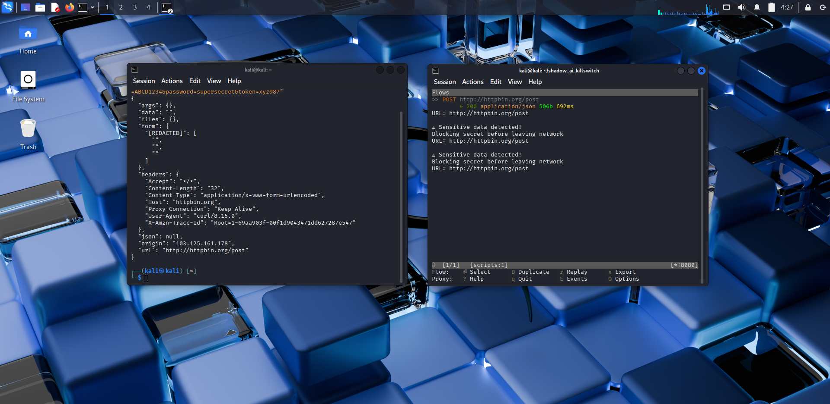

Slide 12
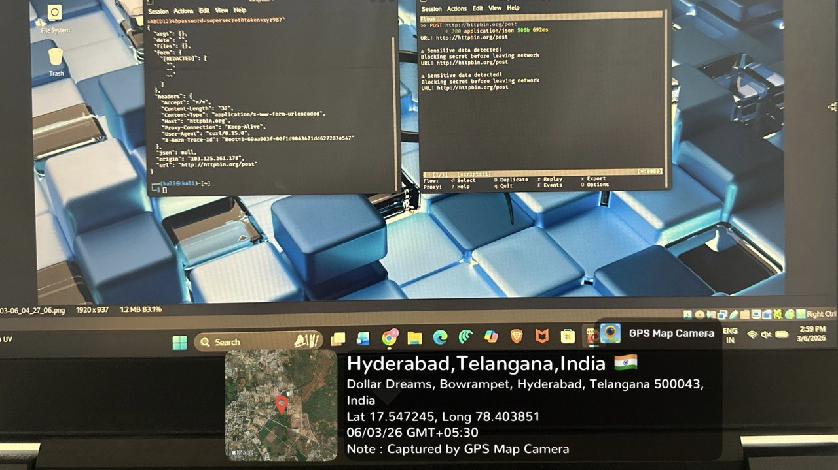

Slide 13
Conclusion
The Shadow AI Kill-Switch provides an effective solution to prevent sensitive data leaks when interacting with external AI tools.
By intercepting network requests and automatically removing confidential information, the system ensures that sensitive organizational data is protected.
This project demonstrates how cybersecurity tools and network monitoring techniques can be used to build a practical Data Loss Prevention system.

